Slide 1

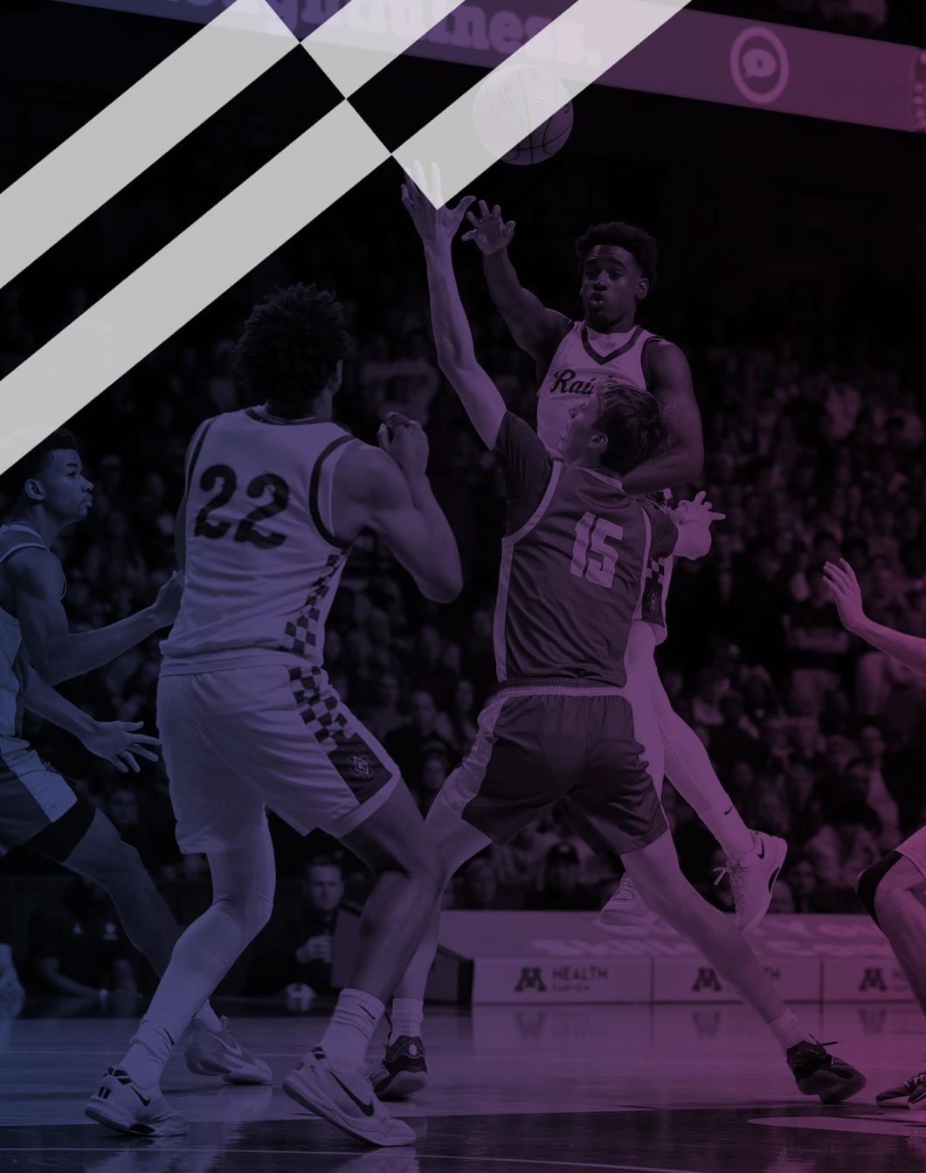

2026-27 NFHS
Basketball Rules
PowerPoint
Rules Changes Editorial Changes Points of Emphasis
Copyright© 2026 National Federation of State High School Associations. All Rights Reserved.
This copyrighted power point is presented by the NFHS. This material shall only be reproduced or distributed by member state associations for teaching and training purposes. Distribution to the public is prohibited without the express written consent from the NFHS. Please contact Davis Whitfield, COO at dwhitfield@nfhs.org with requests.
Notes:
Welcome the group; this session walks through the 2026-27 NFHS basketball rules changes, editorial changes, and points of emphasis.
Remind attendees this material is copyrighted and for member state association teaching and training only.
Frame the goal: consistent interpretation and enforcement on the court this season.

Slide 2
2026 NFHS Basketball Rules Changes
Notes:
Transition slide: we are now moving into the 2026-27 rules changes.

Slide 3
CIF Notes
No changes to 10 second backcourt or closely guarded
Concussion protocols
  Every Unit should offer training
  https://www.cdc.gov/heads-up/training/sports-officials.html
  Officials have the final say whether a player should stay in the game or not
  Refer your coach to the section for the concussion protocol when the player is cleared to play from a doctor. We only have jurisdiction over that game.
Arbiter Registration is Open
  Every official needs to register, take the test and pay the dues.
  Once all of this is complete, the unit will be notified that the official is cleared to be assigned. There are no exceptions for officials this season!

Slide 4

RE-STARTING THE CLOCK 5-9-5 (NEW)
RULES CHANGES
In the last 59.9 seconds of each quarter or extra period, if play is to be resumed by a throw-in or an unsuccessful free throw, a minimum of 3/10ths (.3) of a second must expire on the game clock when the ball is legally touched by a player inbounds
Notes:
New rule: in the last 59.9 seconds of a quarter or overtime, at least 0.3 seconds must elapse on a throw-in or missed free throw before a scoring play can count.
This prevents impossible catch-and-shoot situations.
Officials must know when to run time off the clock.

Slide 5
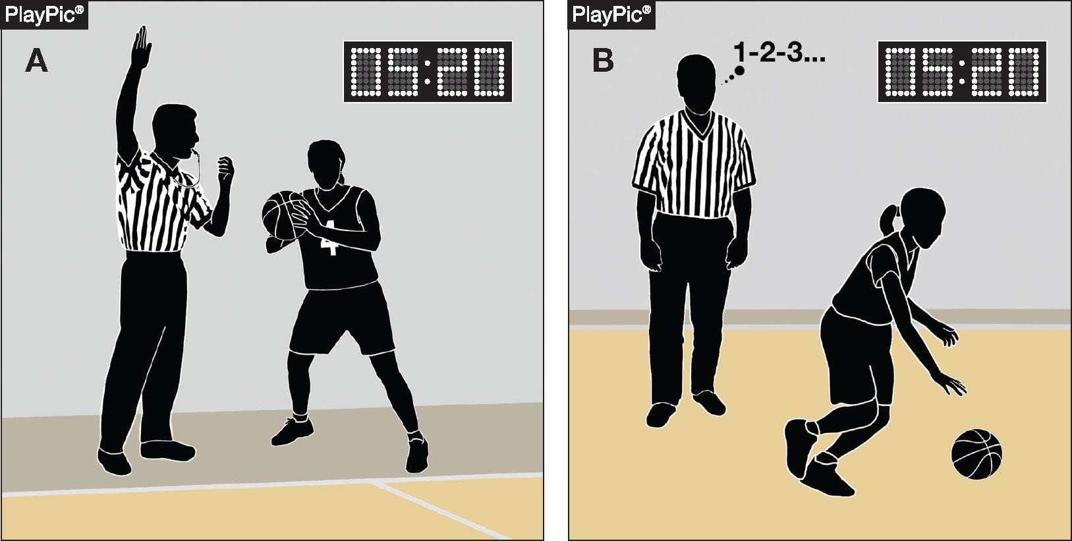
TIMING MISTAKES 5-10-2 NOTE (NEW)
RULES CHANGES
If the referee determines the clock malfunctioned or was not started/stopped properly, or if the clock did not run, an official's count, visible or silent, or other official information may be used to make a correction
Notes:
New: if the clock malfunctions or is not started or stopped properly, officials may use a count (visible or silent) or other official information to correct the time.
Reinforces the officials' authority to fix timing errors.

Slide 6
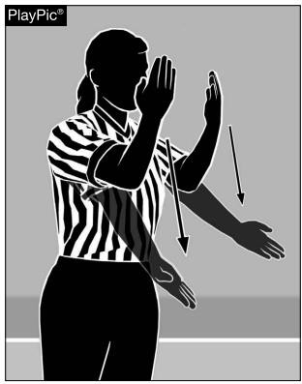
ALTERNATING POSSESSION 6-4-4g
RULES CHANGES
The letter ‘g’ is now eliminated
Play is stopped when there is team control, a goal is scored, or another official stoppage occurs. When play is properly stopped, the ensuing resumption is administered under the appropriate rule for the situation, rather than using the alternating possession procedure (Rule 4-36-2.c)
This is not a rule change; this was inadvertently left in the rule after the rule change in 2025-26
Notes:
The letter 'g' is eliminated, cleaning up language inadvertently left in after the 2025-26 change.
This is not a rule change; resume play under the appropriate rule, not alternating possession.

Slide 7
RESUMING PLAY DIFFERENCES 8-6-4a-d (NEW)
RULES CHANGES
ART 4…When, during the same dead-ball period that follows an infraction or stoppage in play and before the ball becomes live, both teams are assessed technical fouls:
All technical fouls are considered to have been committed at approximately the same time for the purposes of offsetting their penalties;
All fouls are charged, and their penalties are identified;
When there is an unequal number of fouls committed during the dead-ball period, play shall resume as if the last committed single administrative, team, substitute, player, or bench technical foul was the only foul committed; and
If, after the cancellation of the penalties for an equal number of fouls by both teams, the game shall be resumed at the point of interruption.
Notes:
New procedure for when both teams are assessed technical fouls in the same dead-ball period.
Offsetting techs are treated as committed at the same time; with an unequal number, resume as if only the last was called.
With an equal number, penalties cancel and play resumes at the point of interruption.

Slide 8
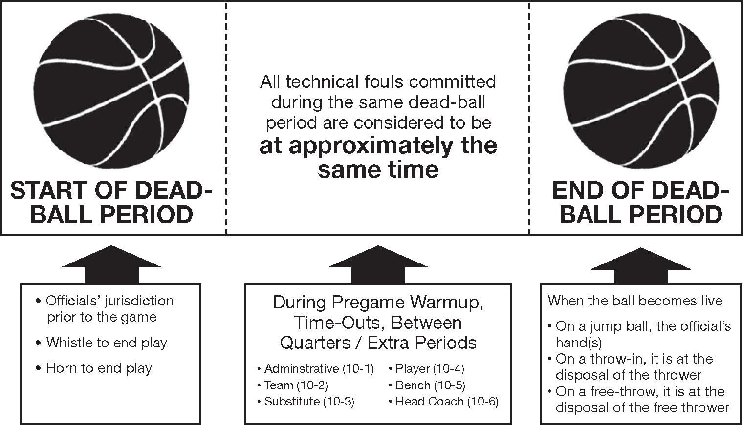
RESUMING PLAY DIFFERENCES 8-6-4a-d (NEW)
RULES CHANGES
All technical fouls committed during the same dead-ball period are considered to be at approximately the same time for purposes of offsetting their penalties
Play resumes at the point of interruption
Notes:
Key takeaway: all technicals in the same dead-ball period offset as if simultaneous.
Play then resumes at the point of interruption.

Slide 9
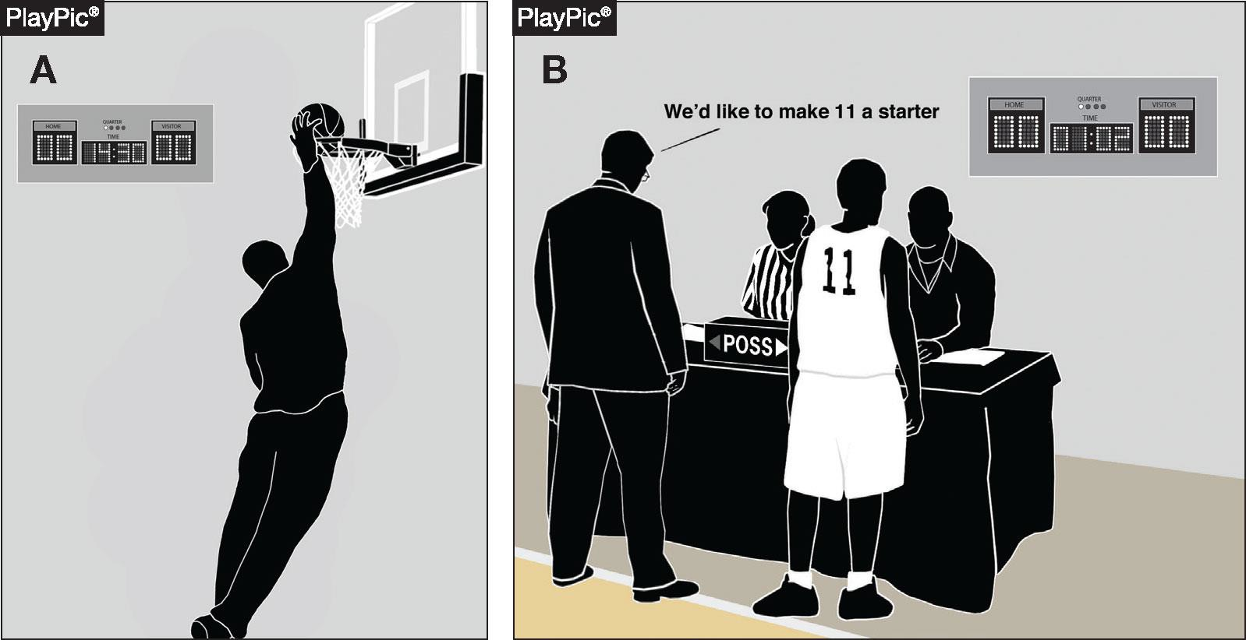
RESUMING PLAY DIFFERENCES 8-6-4a-d (NEW)
RULES CHANGES
While (A) and (B) occur more than 13 minutes apart in the pregame warmup, they are considered to be at approximately the same time for purposes of offsetting their penalties
Notes:
Example: fouls occurring more than 13 minutes apart in warmup still count as 'same time' for offsetting.

Slide 10
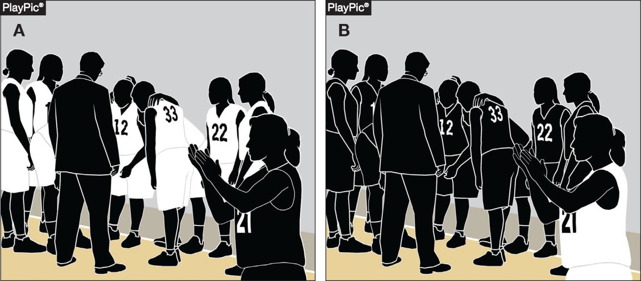
RESUMING PLAY DIFFERENCES 8-6-4a-d (NEW)
RULES CHANGES
Even though the unsporting technical fouls are committed at the start (A) and end (B) of the time-out, they are considered to be at approximately the same time for purposes of offsetting their penalties
Notes:
Example: unsporting technicals at the start and end of a time-out still offset as simultaneous.

Slide 11
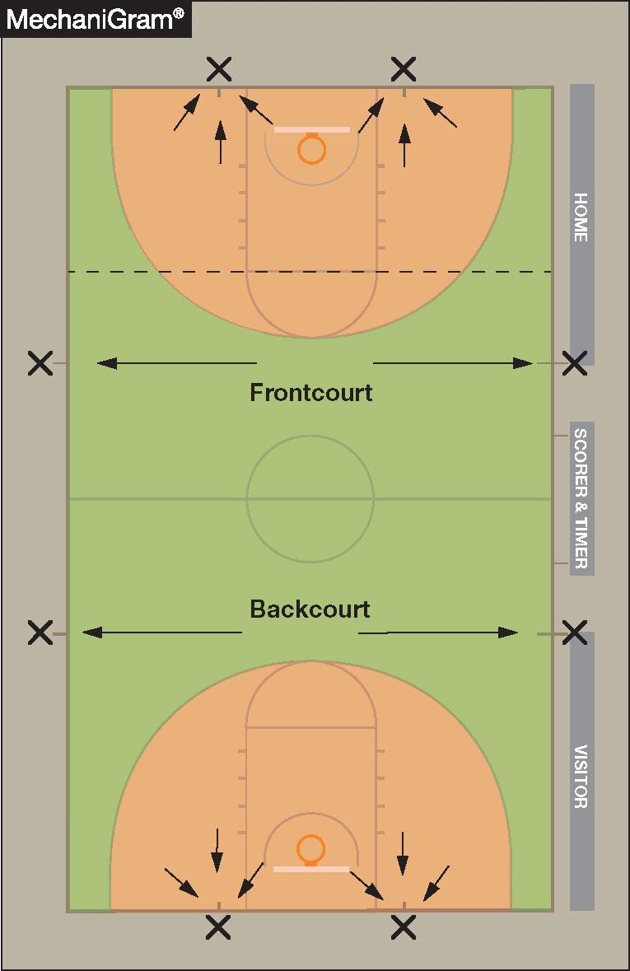
THROW-IN PROVISIONS 9-2 (PENALTY)
RULES CHANGES
When an infraction occurs on a throw-in, the location of the violation is the original throw-in spot
If the original throw-in spot is not a designated spot, the ensuing throw-in is moved to such a spot (as indicated in the diagram)
Notes:
A throw-in violation is spotted at the original throw-in location.
If that spot is not a designated spot, move the throw-in to the nearest designated spot.

Slide 12
2026 NFHS Basketball Editorial Changes
Notes:
Transition slide: these are editorial changes, clarifications rather than substantive rule changes.

Slide 13
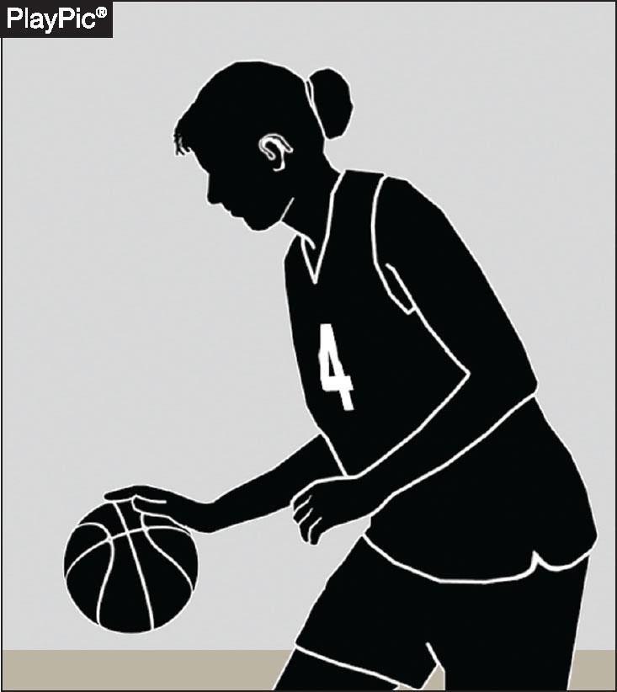
ELECTRONIC DEVICES 1-19 NOTE (NEW)
EDITORIAL CHANGES
NOTE: Communication between a coach and player through electronic devices is prohibited
Hearing aids are legal
Notes:
Coach-to-player communication through electronic devices is prohibited.
Hearing aids remain legal.

Slide 14
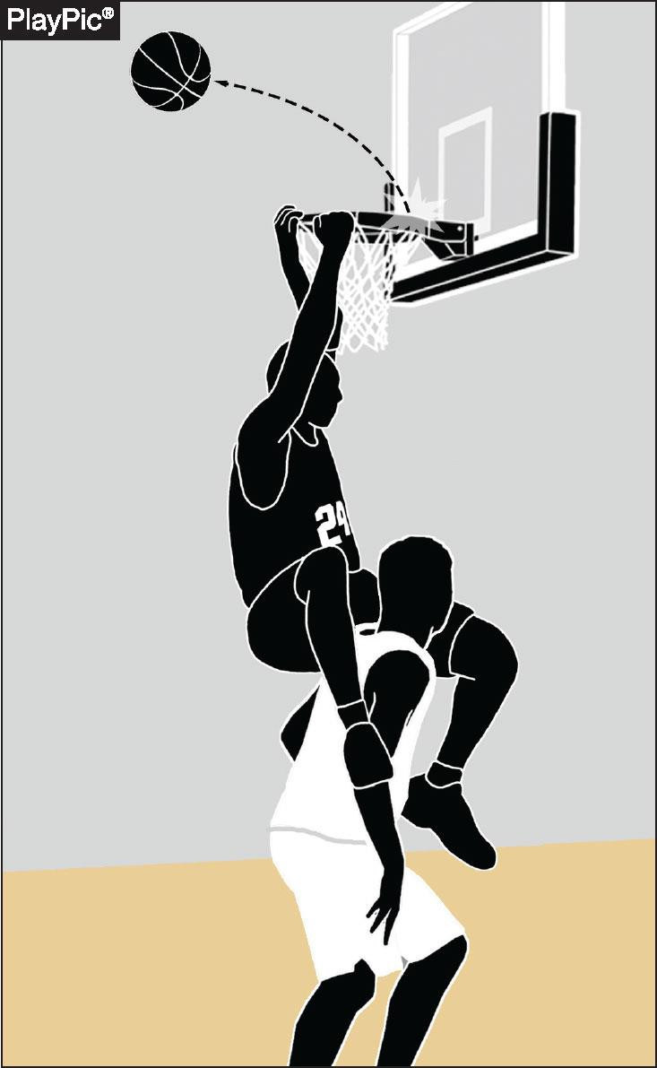
AIRBORNE SHOOTER
4-1-1 EXCEPTION (NEW)
EDITORIAL CHANGES
A player is not considered an airborne shooter when hanging on the rim after a dunk attempt
If the dunk attempt is successful, the ball becomes dead when it passes through the basket; any subsequent contact between the player who dunked the ball and an opponent shall be ignored unless the contact is ruled intentional or flagrant
If the dunk attempt is unsuccessful and the ball remains live, any illegal contact between the player who attempted the dunk and an opponent shall be ruled a common foul and administered according to the bonus situation
Notes:
A player hanging on the rim after a dunk attempt is not an airborne shooter.
Successful dunk: the ball is dead once through the basket; ignore later contact unless intentional or flagrant.
Unsuccessful dunk with a live ball: illegal contact is a common foul, administered per the bonus.

Slide 15
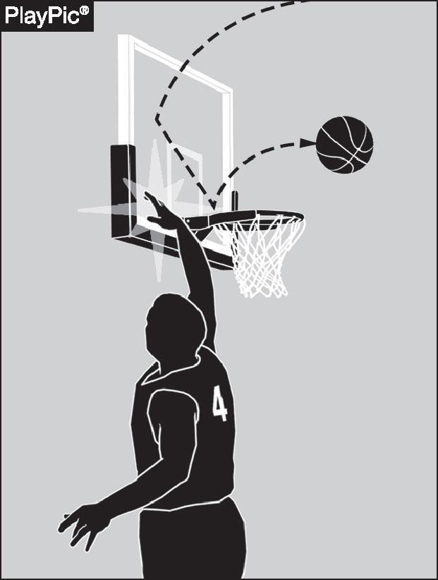
BASKET INTERFERENCE 4-6-2
EDITORIAL CHANGES
Occurs when a player slaps or strikes the backboard, causing the backboard or ring to vibrate during a try for goal that has the possibility of entering the basket
Notes:
Basket interference now covers slapping or striking the backboard, causing it or the ring to vibrate during a try that could score.
The old cylinder-specific language has been removed.

Slide 16
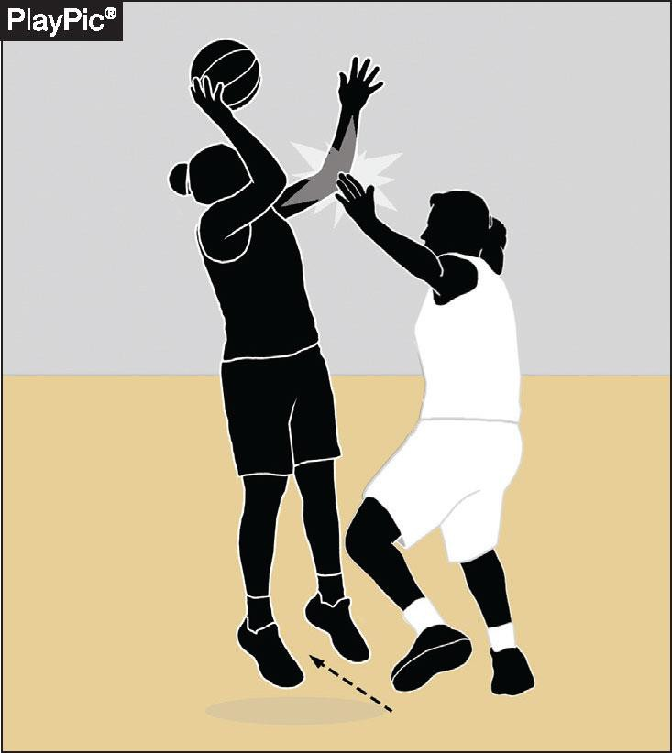
CONTINUOUS MOTION
EDITORIAL CHANGES
4.11.2 (SITUATION)
Stepping or pivoting toward the basket is not required to be considered in the act of shooting
A player may step in a direction that creates space in order to attempt a try, which may be lateral or away from the basket
Notes:
Stepping or pivoting toward the basket is not required to be in the act of shooting.
A player may step laterally or away to create space and still be considered shooting.

Slide 17
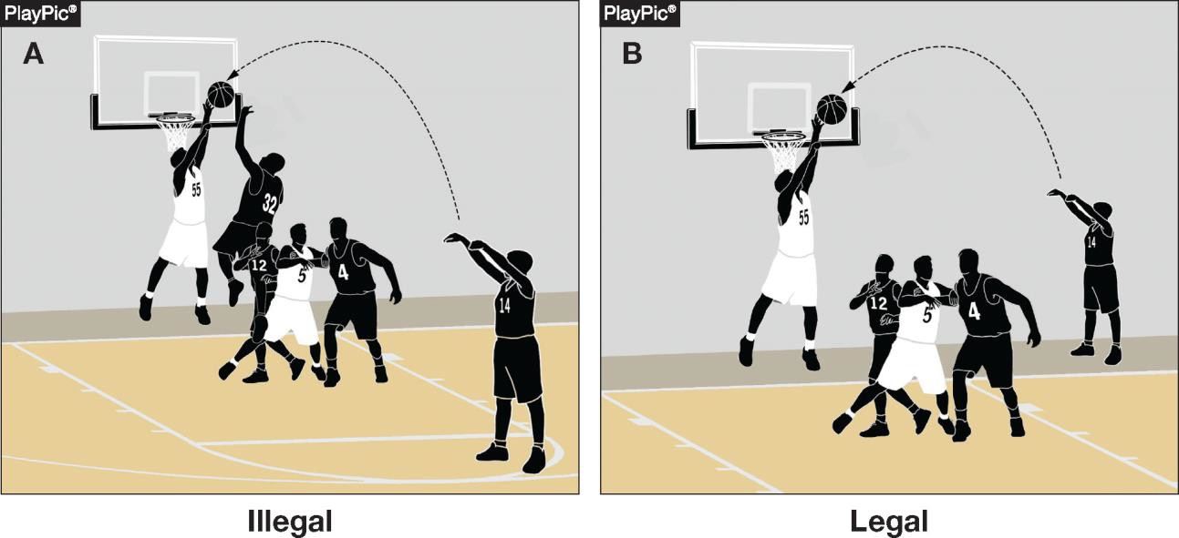
GOALTENDING
4-22-1 NOTE (NEW)
EDITORIAL CHANGES
When a defensive player touches a thrown or tapped ball while it is in its downward flight entirely above the basket, has the possibility of entering the basket and is not touching the basket cylinder
Goaltending does not apply to a ball released on a throw-in pass
Notes:
New note: goaltending is touching a ball in downward flight, entirely above the basket, with a chance to score, and not on the cylinder.
Goaltending does not apply to a ball released on a throw-in pass.

Slide 18
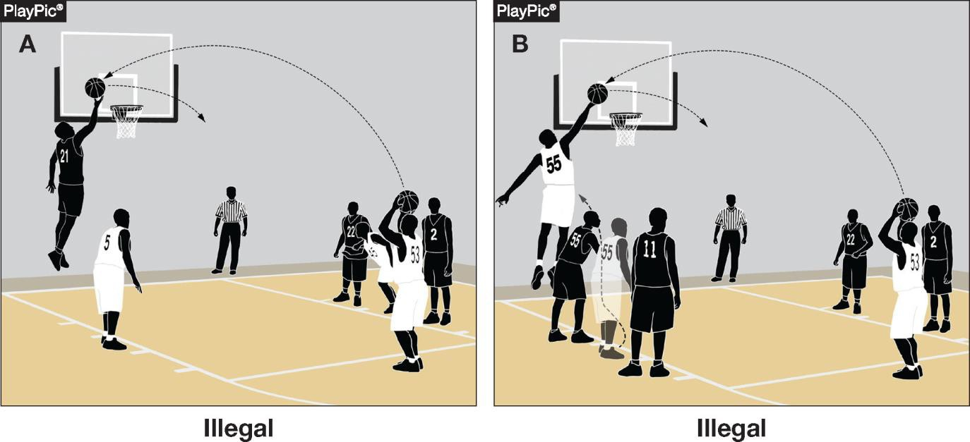
GOALTENDING 4-22-2
EDITORIAL CHANGES
When a player touches the ball outside the cylinder during a free-throw attempt
Committing goaltending during a free throw is also a player technical foul (see 10- 4-8)
Notes:
Touching the ball outside the cylinder during a free throw is goaltending.
On a free throw it is also a player technical foul (10-4-8).

Slide 19
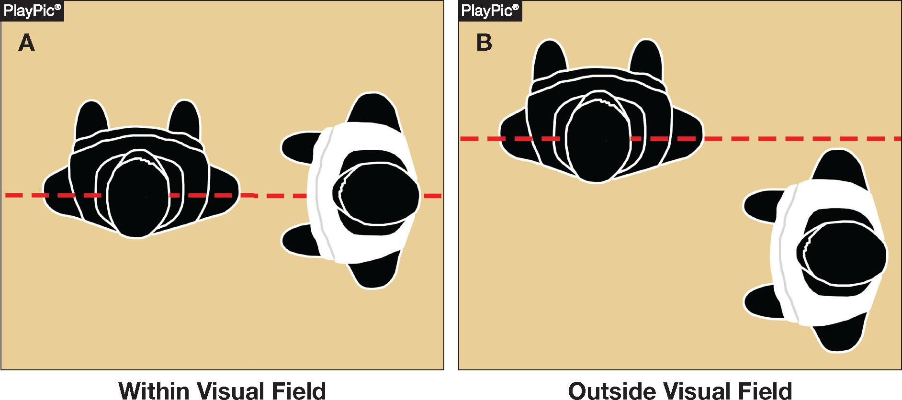
SCREEN
4-40-3 NOTE (NEW)
EDITORIAL CHANGES
The visual field of a player being screened includes the player’s forward vision and peripheral vision and extends horizontally from the ear
Notes:
The screened player's visual field includes forward and peripheral vision, measured horizontally from the ear.
Use this to judge how much time and distance a screener must give.

Slide 20
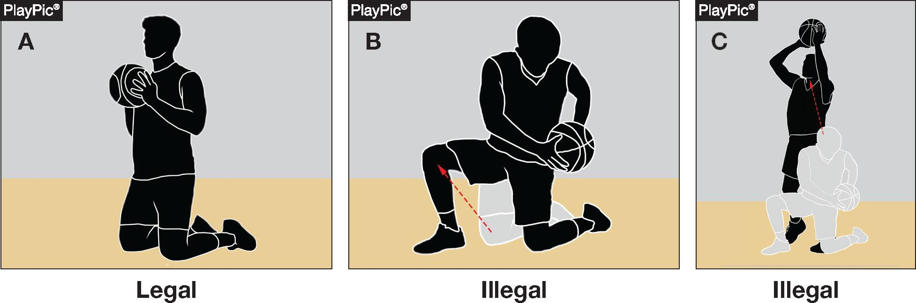
TRAVELING 4-44-5b
EDITORIAL CHANGES
A player holding the ball on the floor may not attempt to
stand up with the ball
Notes:
A player holding the ball on the floor may not attempt to stand up with it.

Slide 21
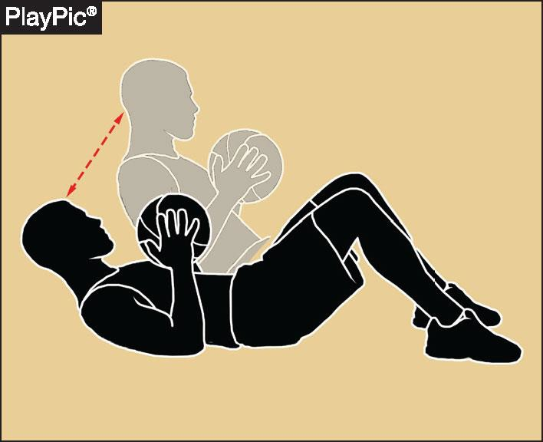
TRAVELING
EDITORIAL CHANGES
4.44.5 (SITUATION)
A player holding the ball flat on their back may sit up without traveling
The player may also return to a position on their back
Notes:
A player holding the ball flat on their back may sit up without traveling, and may return to their back.

Slide 22
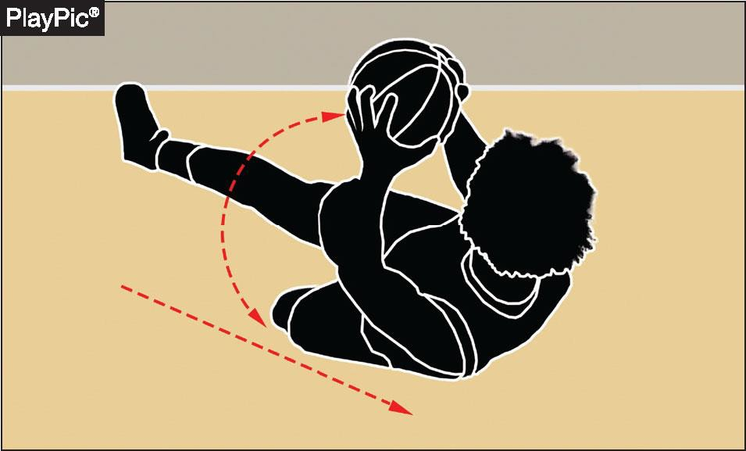
TRAVELING
4-44-5c (NEW)
EDITORIAL CHANGES
A player holding the ball… after gaining control while on the floor, may slide and/or roll with the ball if it is caused by the player’s momentum
Notes:
After gaining control while on the floor, a player may slide or roll with the ball if it is caused by their own momentum.

Slide 23
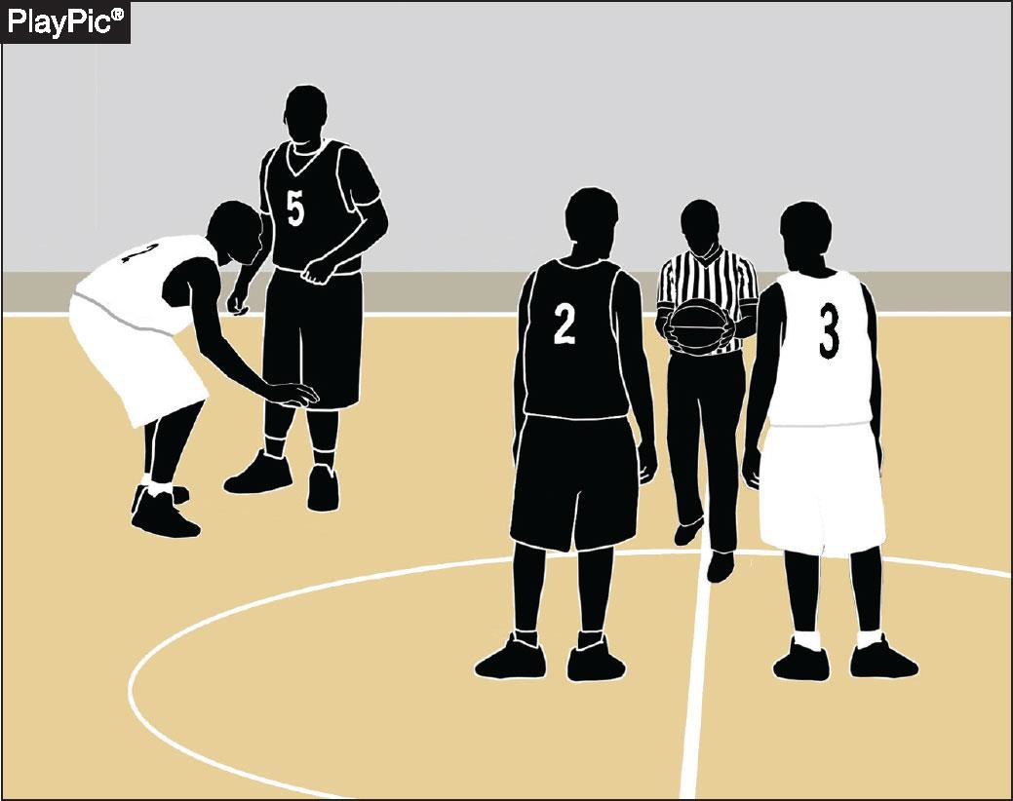
JUMP-BALL ADMINISTRATION 6-3-2
EDITORIAL CHANGES
“When the official enters the center restraining circle” has
replaced the former language “is
ready”
Notes:
'When the official enters the center restraining circle' replaces the former 'is ready' language.
This defines the trigger point for jump-ball restrictions.

Slide 24
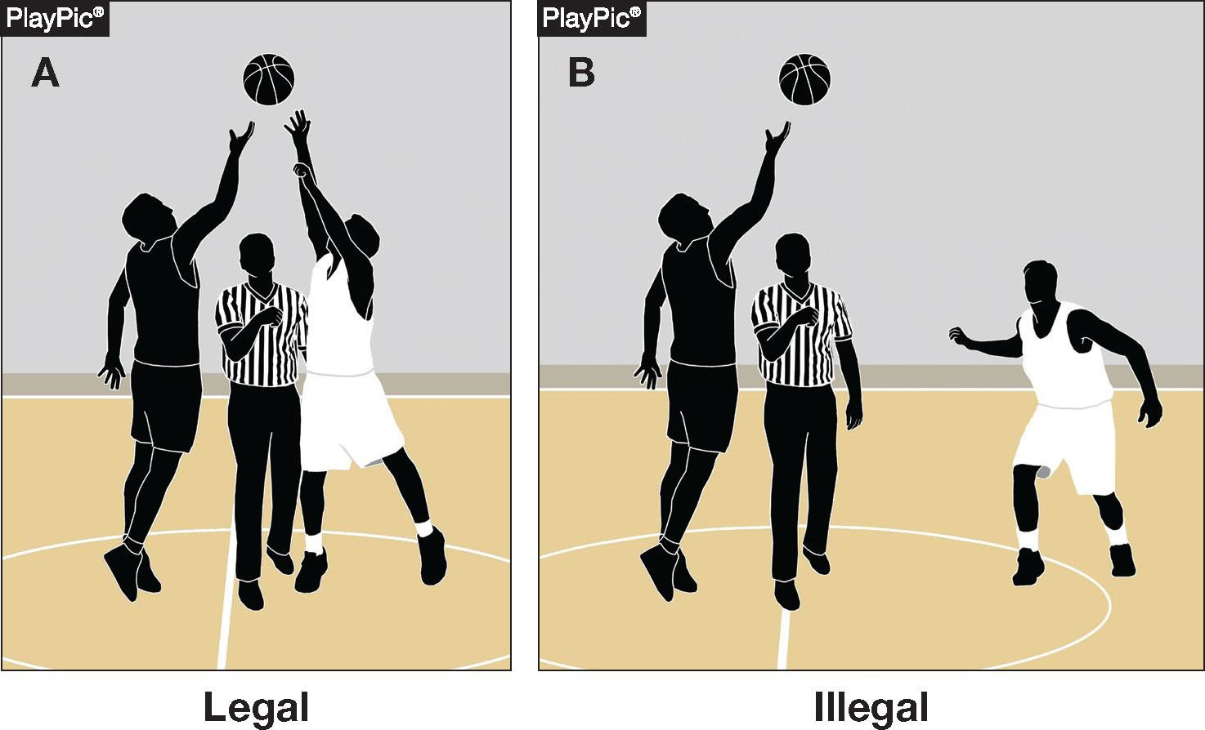
JUMP-BALL ADMINISTRATION 6-3-4 NOTE (NEW)
EDITORIAL CHANGES
Each jumper shall have both feet within their half of the center restraining circle until the jump-ball ends
The restrictions end when the ball is touched by one or both jumpers
Notes:
Each jumper must keep both feet within their half of the center restraining circle until the jump-ball ends.
The restriction ends when the ball is touched by one or both jumpers.

Slide 25
RESUMPTION-OF-PLAY PROCEDURE, THROW-INS
7-5-6c (NEW)
EDITORIAL CHANGES
When a throw-in violation occurs during a division line throw-in, the resulting throw-in shall remain at the division line opposite the scorer’s and timer’s table
Clarifies that in this situation, the throw-in would not be moved to one of the eight designated spots to resume play
Notes:
A throw-in violation during a division-line throw-in keeps the throw-in at the division line opposite the table.
It is not moved to one of the eight designated spots.

Slide 26
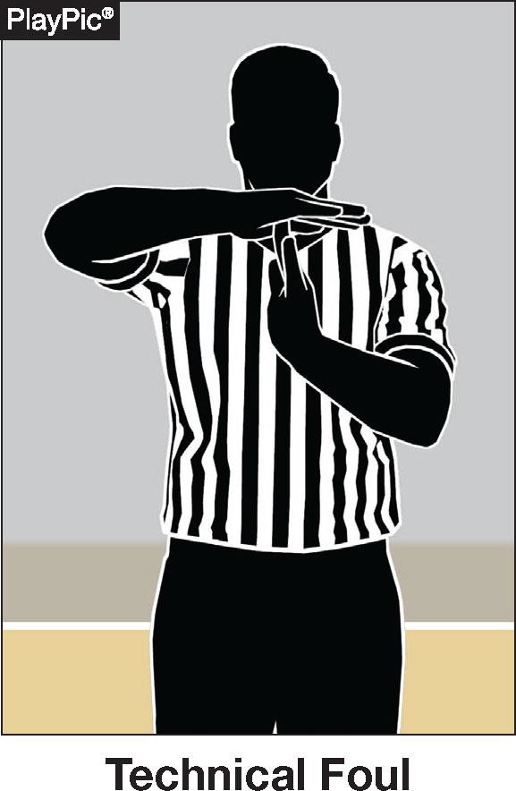
TECHNICAL FOUL
PENALTY SUMMARY CHART
EDITORIAL CHANGES
The Technical Foul Penalty Summary chart has been revised to better align with Rule 10
Notes:
The Technical Foul Penalty Summary chart is revised to better align with Rule 10.
Use it as a quick on-court reference.

Slide 27
2026 Points of Emphasis
Notes:
Transition slide: these are the 2026 points of emphasis, areas that need consistent enforcement.

Slide 28
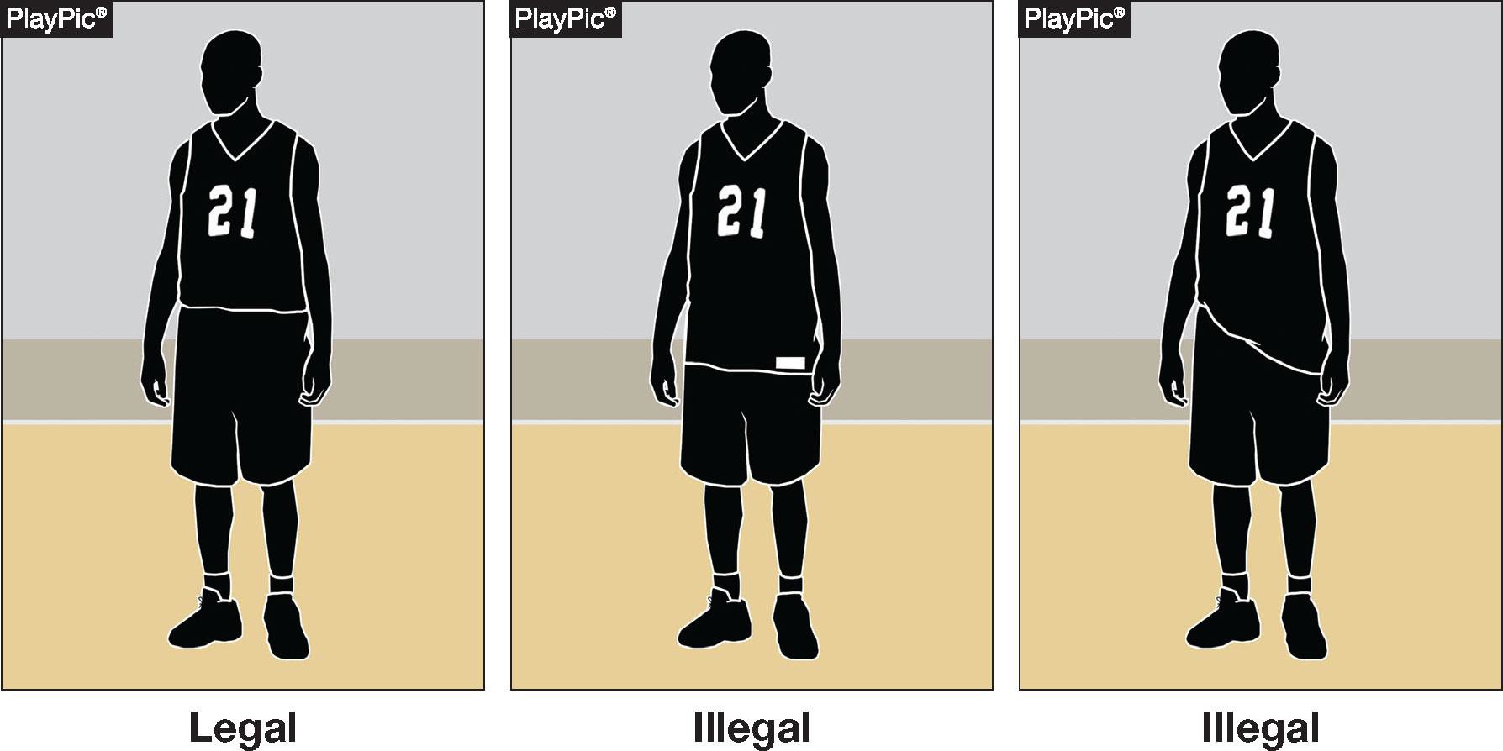
UNIFORMS
POINTS OF EMPHASIS
Uniforms shall be worn in the manner the manufacturer intended
Players not in compliance with Rule 3-3-5 shall be directed to leave the game until corrected (as outlined in Rule 3-3-4)
Notes:
Uniforms must be worn in the manner the manufacturer intended.
Players not in compliance with 3-3-5 are directed to leave the game until corrected.

Slide 29
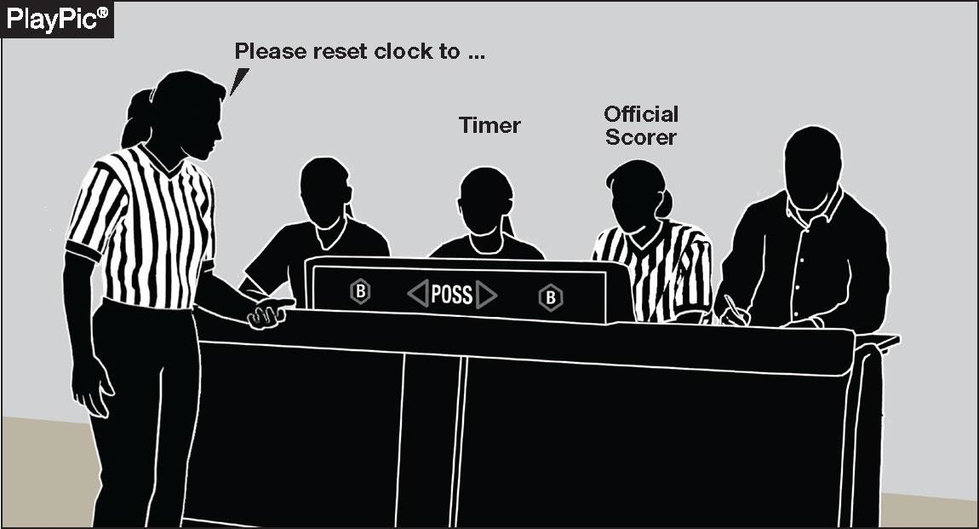
TIMING MISTAKES / OFFICIALS’ COUNTS
POINTS OF EMPHASIS
Accurate timing is essential to game integrity and competitive balance
Officials and table personnel must work collaboratively
Notes:
Accurate timing is essential to game integrity and competitive balance.
Officials and table personnel must work collaboratively.

Slide 30
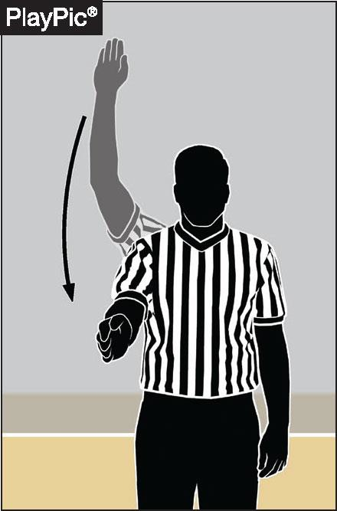
TIMING MISTAKES / OFFICIALS’ COUNTS
POINTS OF EMPHASIS
When timing mistakes or equipment issues occur, officials may utilize visible or silent counts
Strong communication between officials and
the scorer’s table is essential
Notes:
When timing mistakes or equipment issues occur, officials may use visible or silent counts.
Strong communication between officials and the scorer's table is essential.

Slide 31
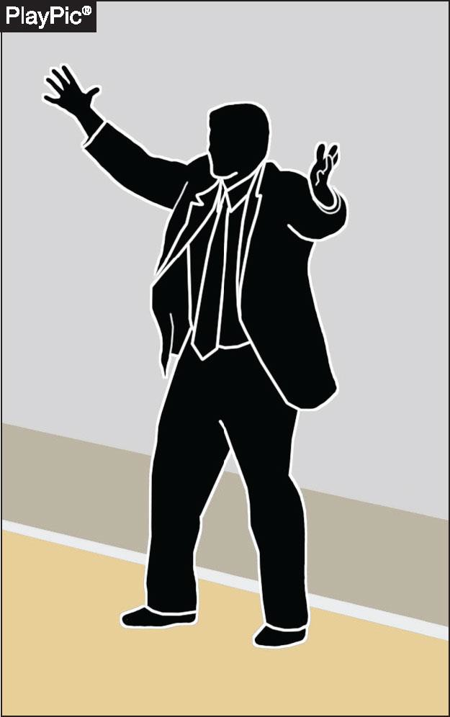
BENCH DECORUM / SPORTSMANSHIP / PROFESSIONAL CONDUCT
POINTS OF EMPHASIS
Sportsmanship is a core expectation of education-based basketball
Consistent professionalism, respect and sportsmanship is required from coaches, players and officials
Notes:
Sportsmanship is a core expectation of education-based basketball.
Consistent professionalism, respect, and sportsmanship are required from coaches, players, and officials.

Slide 32
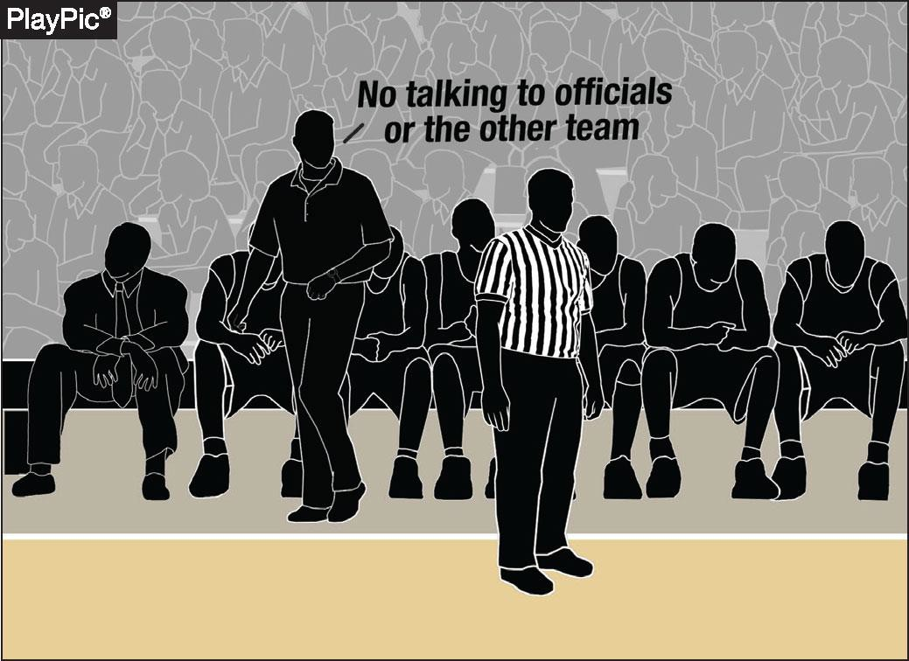
BENCH DECORUM / SPORTSMANSHIP / PROFESSIONAL CONDUCT
POINTS OF EMPHASIS
The head coach is responsible for all bench personnel and communication with officials
Taunting (actions or remarks intended to embarrass, ridicule or demean an opponent) has no place in high school basketball and must be addressed promptly and consistently per NFHS rules
Notes:
The head coach is responsible for all bench personnel and communication with officials.
Taunting has no place in high school basketball and must be addressed promptly and consistently.

Slide 33
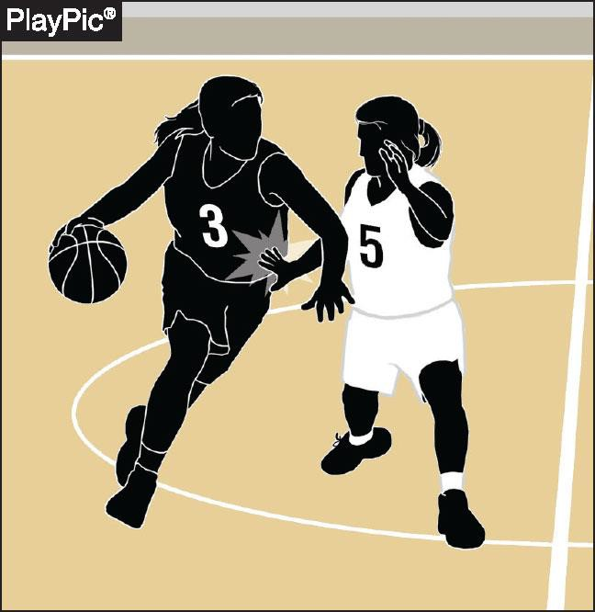
PHYSICAL PLAY / ILLEGAL CONTACT
POINTS OF EMPHASIS
Unnecessary or illegal contact creates disadvantage and safety concerns
Officials, coaches and players must collectively ensure legal play is distinguished from illegal physical advantage
Illegal contact includes hand checking, displacement, push-offs using the controlling arm and other actions that restrict freedom of movement or violate legal guarding principles
Notes:
Unnecessary or illegal contact creates disadvantage and safety concerns.
Officials, coaches, and players must distinguish legal play from illegal physical advantage.
Watch hand checking, displacement, and push-offs with the controlling arm.

Slide 34
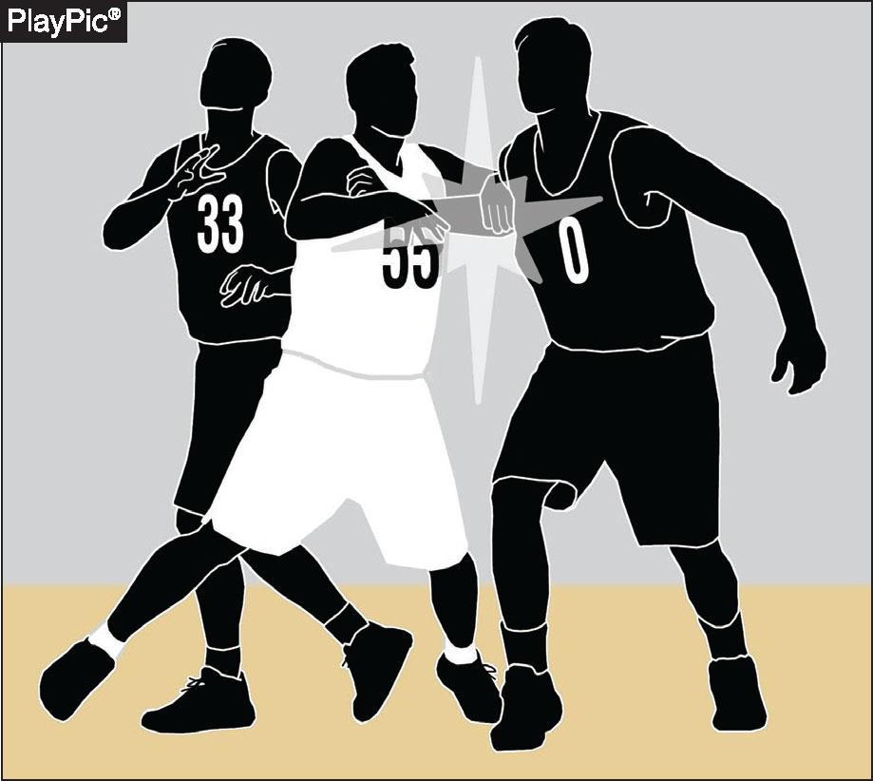
PHYSICAL PLAY / ILLEGAL CONTACT
POINTS OF EMPHASIS
Unnecessary roughness or overly aggressive contact must be penalized to maintain safety and game control
Post play requires special attention, including illegal use of two hands on the back, forearm displacement or dislodging a legally positioned opponent
Notes:
Unnecessary roughness or overly aggressive contact must be penalized to keep the game safe and controlled.
Give post play special attention: two hands on the back, forearm displacement, or dislodging a legal opponent.

Slide 35
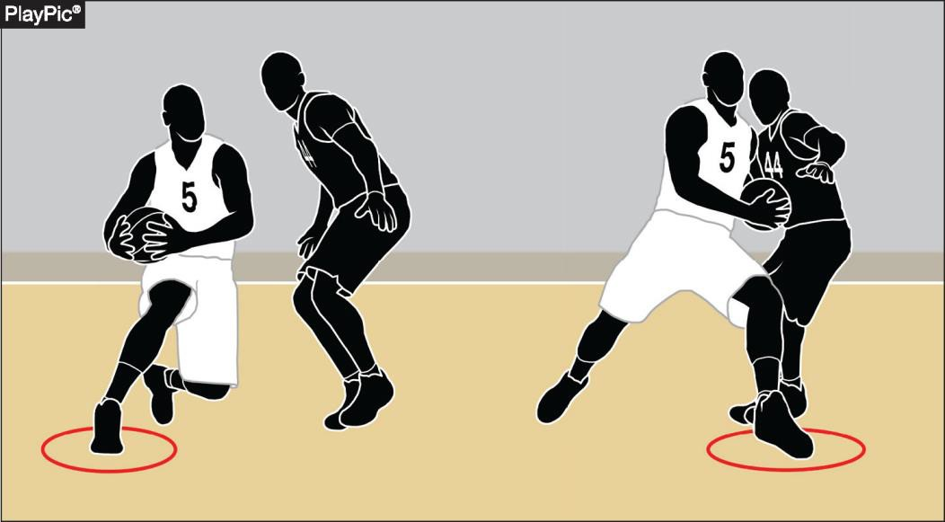
TRAVELING / CONTINUOUS MOTION / LEGAL PLAYER MOVEMENT
POINTS OF EMPHASIS
Proper enforcement of traveling and continuous motion continues to be of high priority to the committee
Moves such as Euro-steps, spin moves and jump stops are legal when executed within the limits of establishing and maintaining a pivot foot
Notes:
Proper enforcement of traveling and continuous motion remains a high priority for the committee.
Euro-steps, spin moves, and jump stops are legal when done within pivot-foot limits.

Slide 36
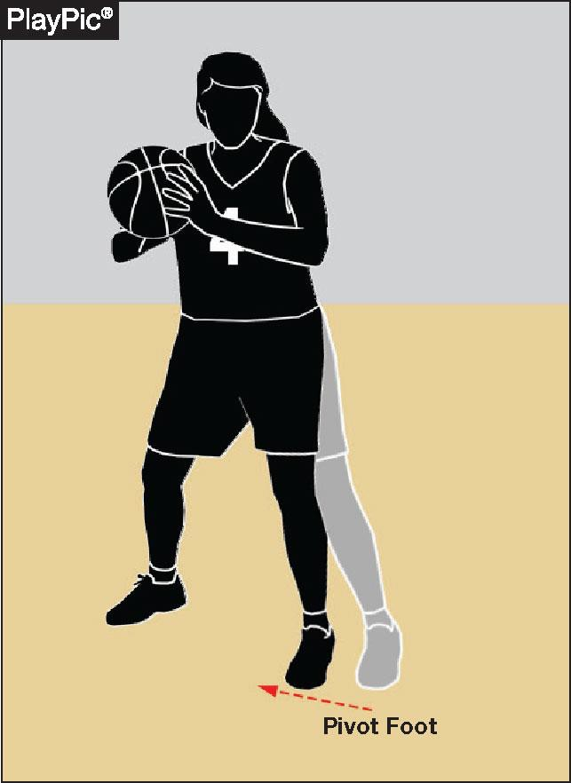
TRAVELING / CONTINUOUS MOTION / LEGAL PLAYER MOVEMENT
POINTS OF EMPHASIS
Dragging a pivot foot, taking extra steps or failing to properly maintain a pivot foot constitutes traveling
A player who is fouled after starting a try or tap for field goal is permitted to complete the customary arm movement, and if pivoting or stepping when fouled, may complete the usual foot or body movement
Continuous motion ends when the ball is clearly in flight
Notes:
Dragging the pivot foot, taking extra steps, or failing to maintain the pivot is traveling.
A player fouled after starting a try may complete the customary arm and foot movement.
Continuous motion ends when the ball is clearly in flight.

